Slide 1
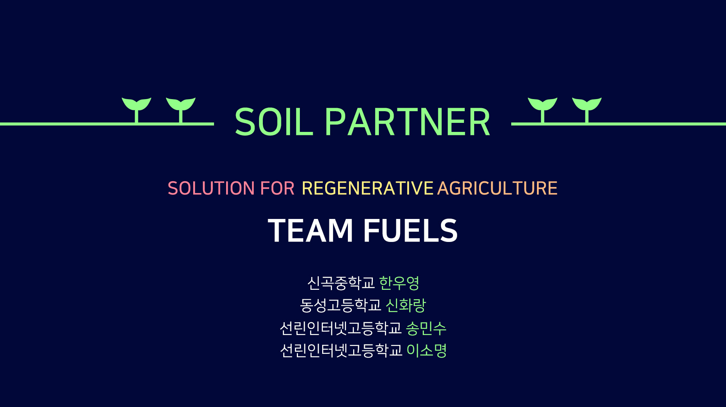

Slide 2
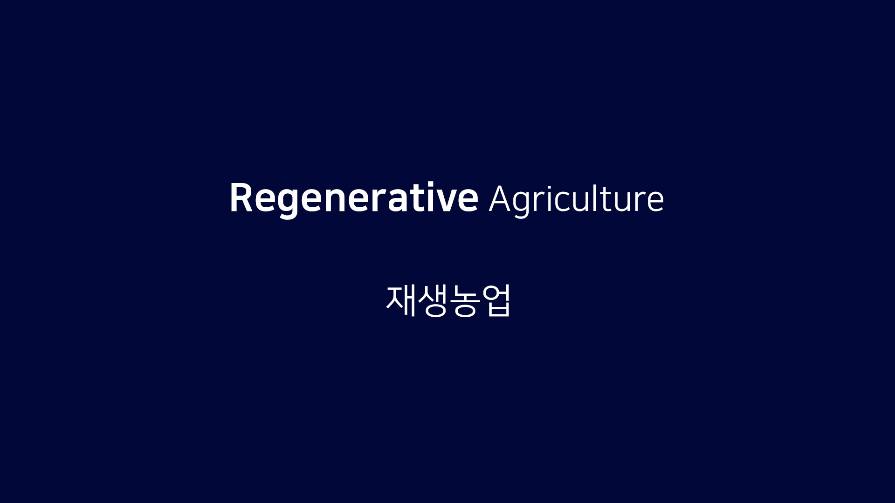

Slide 3
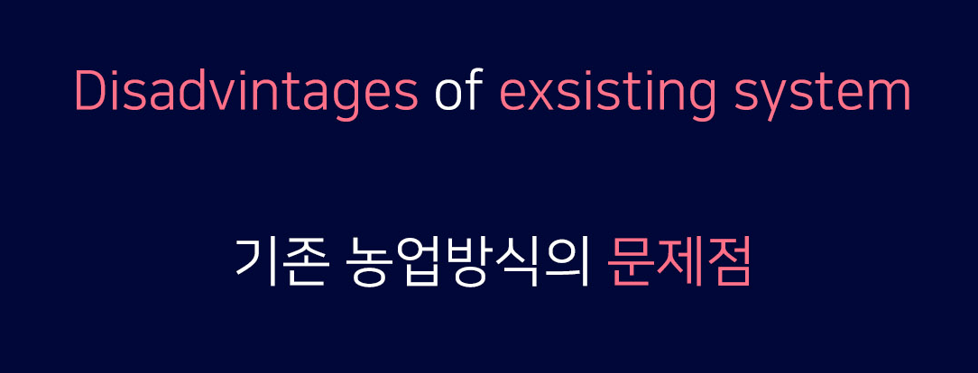
토양 오염
농업 폐수
병충해
Soil pollutions
Agricultural wastewater
Insects pests

Slide 4
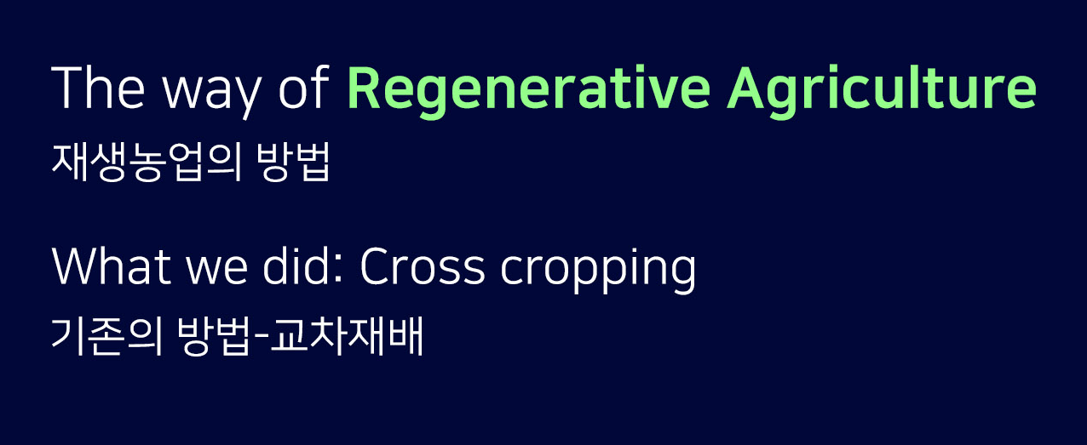
Sollution of NET IMPACT’s paper

Slide 5
Unmet
Needs
- The blank when we changes crops
- Unable to satisfy needs
- A drop of production

Slide 6
Our
Question is...
How could we cultivate
only the crops
that we want to
without using chemicals
which eliminate
pests and weeds?

Slide 7
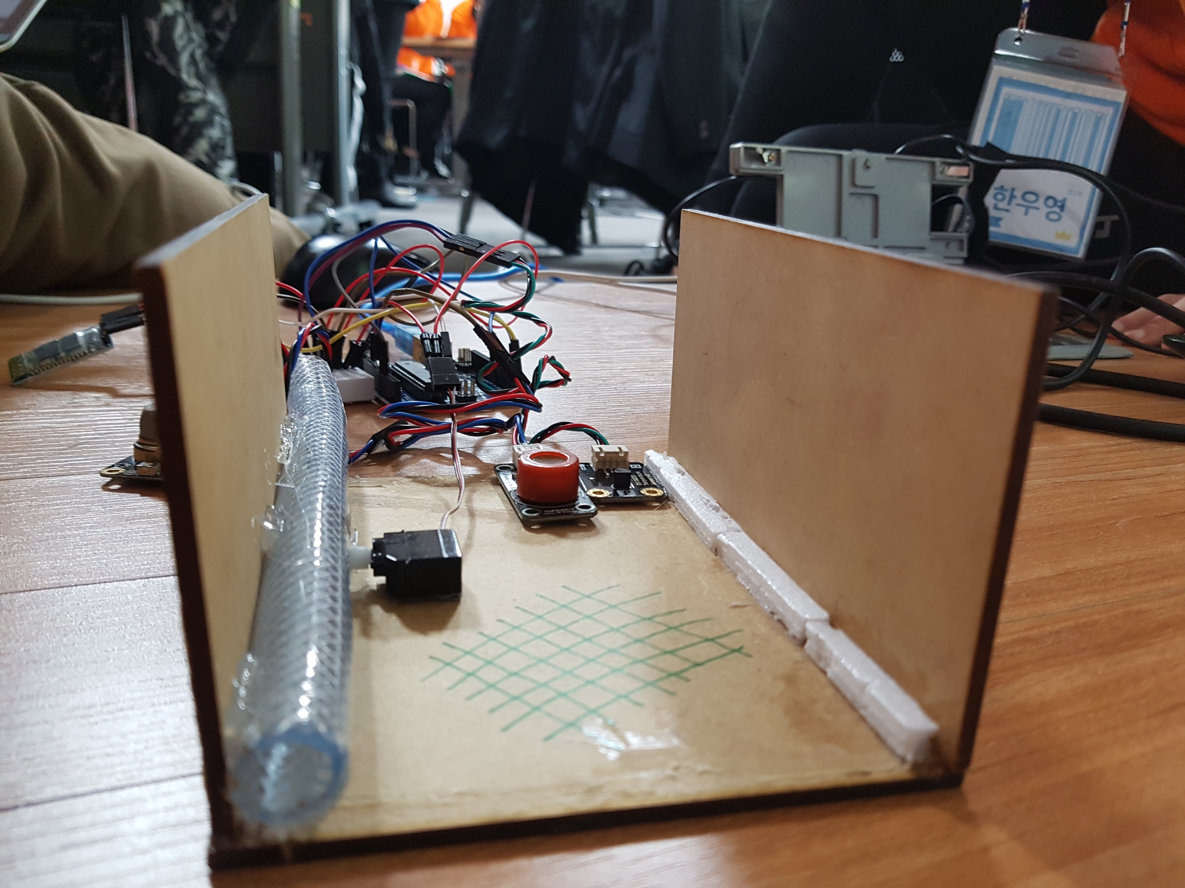
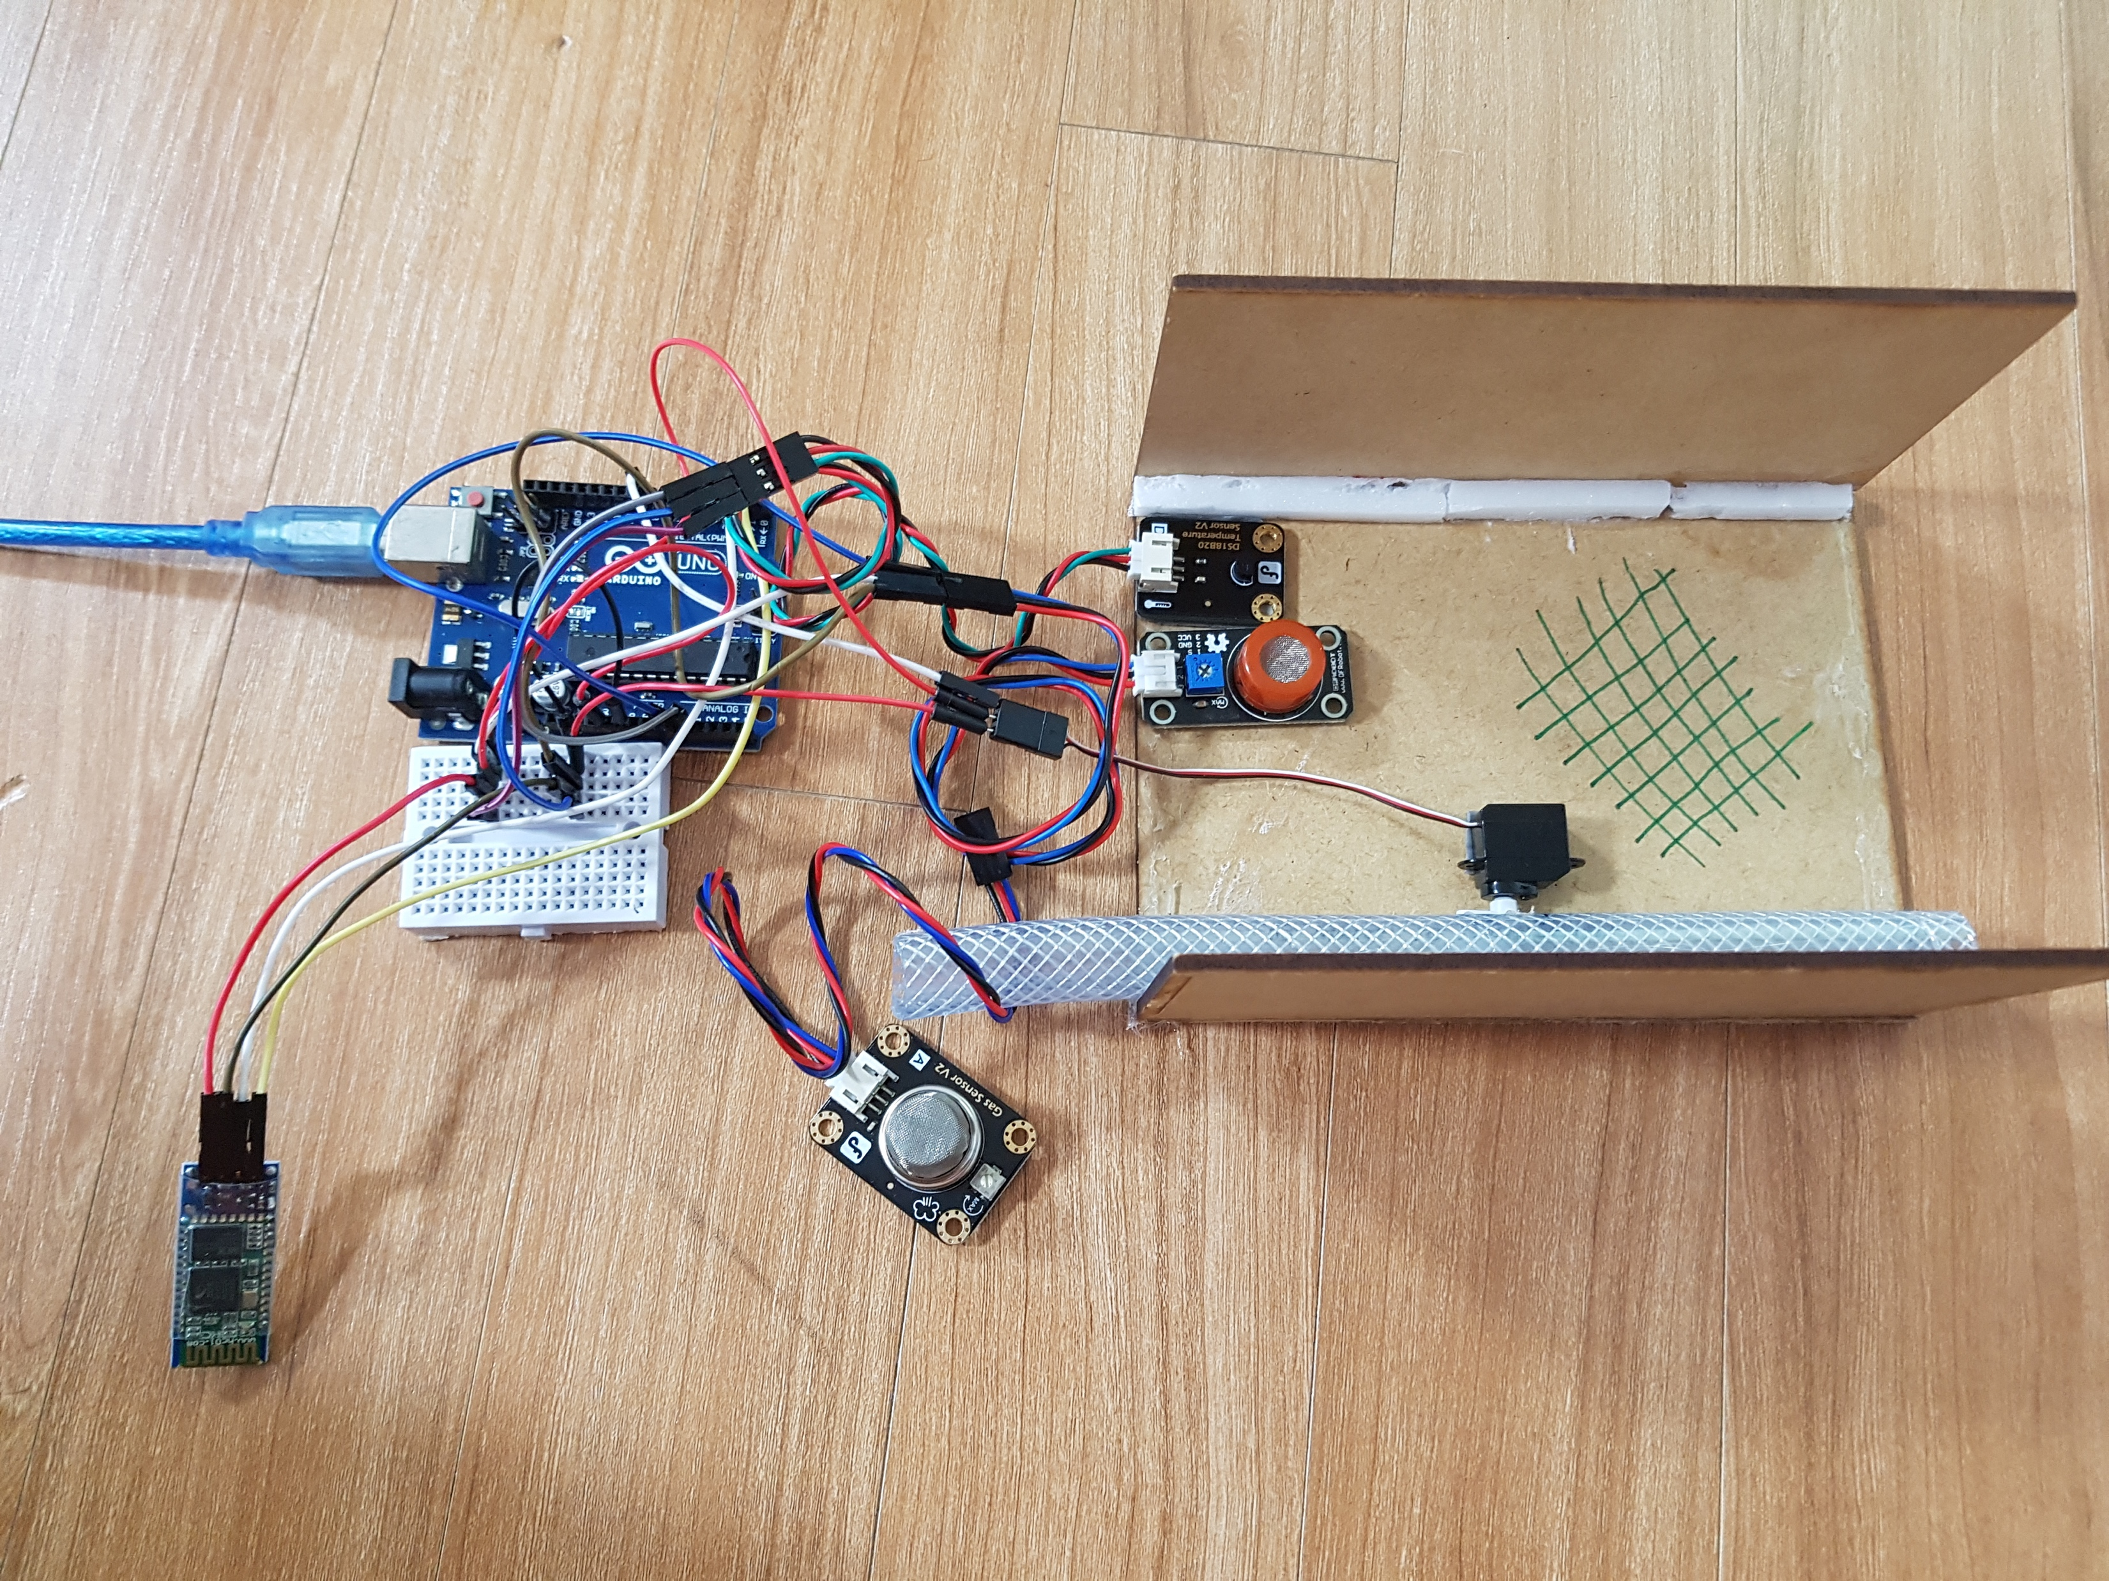
SO WE DID SOMETHING ELSE..

Slide 8
“Soil Partner”

Slide 9
“Soil Partner”

Slide 10
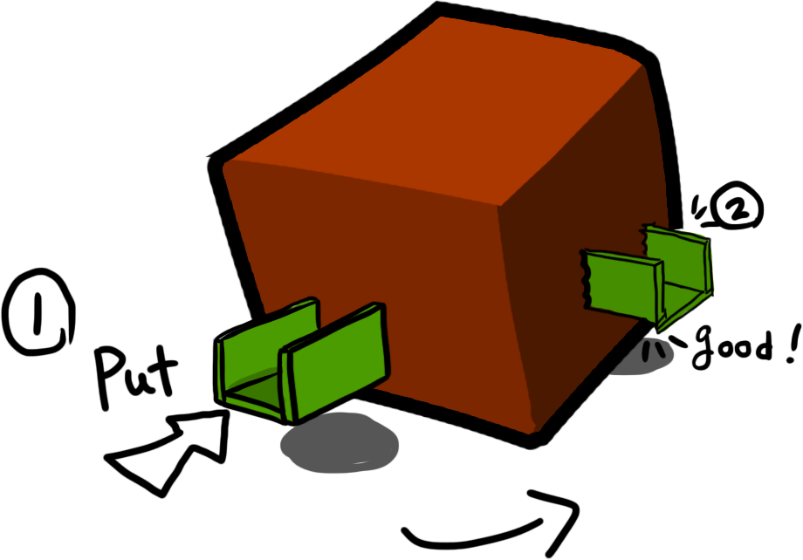
“Soil Partner”
Features
: Install

Slide 11
“Soil Partner”
Features
: Install
When we install this product, we don’t have to plow the field.
*when we plow the field, it has bad affect for field.

Slide 12
“Soil Partner”
Features
: Control Weeds
With this product’s wall, we can protect our crops
from weeds.

Slide 13
“Soil Partner”
Features
: Additional Features
- Water pipe
- IoT System
- Temp / Gas
- Auto water
supply

Slide 14
Time is up..

Slide 15
Thank you

